Slide 1

1.3.2 Lecture slides with audio
Grand growth narrative
Inequality & humanity
<https://github.com/braddelong/public-files/blob/master/econ-115-module-1-lecture-3.2-inequality-%23tceh.pptx>
What has gone badly wrong
Slouching towards utopia?
Link
Link

Slide 2
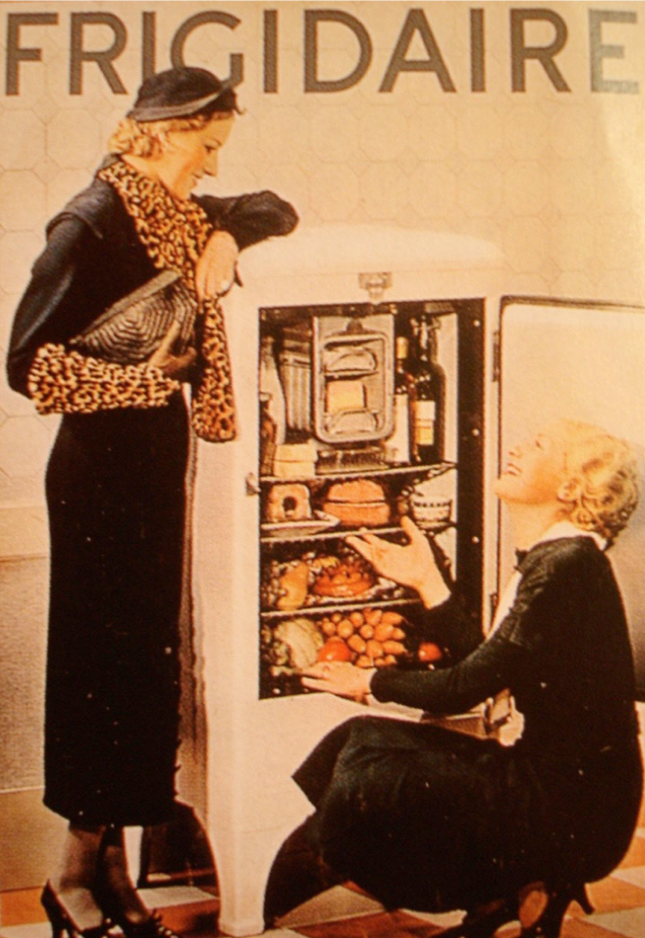

Lecture: 1.3.2. Inequality & Humanity
Feminism, demography, inclusion
Bellamy’s Looking Backward: The elimination of housework, and of a servant class:
‘“Who does your house-work, then?” I asked.
‘“There is none to do,” said Mrs. Leete.… “Our washing is all done at public laundries at excessively cheap rates, and our cooking at public kitchens. The making and repairing of all we wear are done outside in public shops. Electricity, of course, takes the place of all fires and lighting. We choose houses no larger than we need, and furnish them so as to involve the minimum of trouble to keep them in order. We have no use for domestic servants….
‘“What a paradise for womankind the world must be now!” I exclaimed. “In my day, even wealth and unlimited servants did not enfranchise their possessors from household cares, while the women of the merely well-to-do and poorer classes lived and died martyrs to them…”’
What has happened to patriarchy since 1870?
What has happened to gender roles in production and consumption since 1870?
What has happened to demography since 1870?
1:45 of audio in this slide; 14:00 of audio in this slide group
Notes:
Our first theme group for this course is: technology, engineering, capital accumulation, and wealth—the cornucopia of power to manipulate nature and to organize ourselves productively that is the greatest single differentiator of our civilization from all previous.
Our second theme group involves distribution. Who is included in society—has a right to claim social power, and then to use that social power to get a fair share, or even a share, of human productivity? And who, by contrast, is not one of the equals—¸and is to be motivated by fear of the lash, of being beaten, of being shunned, of being imprisoned?
Here we have a quote from one of the best-selling novels of the 1880s: Edward Bellamy’s utopian _Looking Backward_: it is a look at what Bellamy in 1887 hoped society would be like in 2000, framed as the year 2000 looking back at the 1880s. It is an awful novel. But it is very interesting. I do recommend skimming it—sometime.
Bellamy thought, or hoped, that technological progress and the advance of social solidarity—mass production and economies of scale—plus a change of heart in which people are happy being equal to others would make 2000 a relative paradise for the female half of humanity.
To what extent have his hopes come true? What has happened to patriarchy since 1870? What has happened to gender roles in production and consumption since 1870? And what has happened to demography—population growth and childbearing patterns—since 1870?

Slide 3
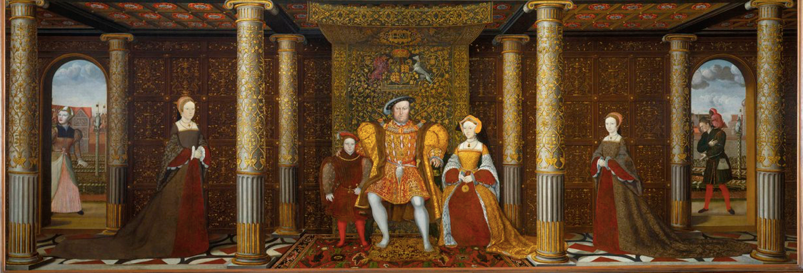
Childbed: British Queens
16 generations from Henry IV to Victoria
5 queens (or heiresses apparent) dead in childbed: Charlotte (Victoria’s generation), Catherine Parr, Jane Seymour, Elizabeth of York, Mary de Bohun
At an average of two queens per generation, this is a 16% childbed mortality rate for the most cosseted women in England
2% maternal mortality per birth
1% extra mortality from nursing sick children
2:00 of audio in this slide
Notes:
Being female back before 1870 was not for sissies.
Consider the queens of England from the accession of the House of Lancaster (on whom the Lannisters of Game of Thrones were largely modeled) to the beginnings of modern medicine and the transition to what we now call the House of Windsor (they changed their name from the House of Saxe-Coburg-Gotha during World War I, as the rulers of England should not have a German dynastic name).
16% of them—Charlotte, Catherine Parr, Jane Seymour, Elizabeth of York, Mary de Bohun—died in childbed. For these women, the most cosseted women in England, with as much social power as possible directed toward their safety and well-being, each childbirth brought with it one chance in 50 of dying. Reproduction is rough on women. And even upper class women in agrarian age societies were not in what our gynecological specialists today would regard as proper health to have a baby.
My great-grandmother Eleanor Lawson Carter Lord, walk up apartment on Commonwealth Avenue in Boston a couple of blocks from Boston Common, as WASPy an upper-class Boston Brahmin as you can imagine, swam the Hellespont and joined communist-front organizations for world peace in the years after World War II—she expected to lose a tooth every time she had a baby, as the calcium for the baby’s bones had to come from somewhere, and her teeth were an obvious place to draw it from.
Take your prenatal vitamins, people!
Again: being female back before 1870 was not for sissies. And we are talking just about the biology of reproduction in a world close to the Malthusian edge of poverty and resource scarcity. We are not even talking about the “Handmaid’s Tale” restrictions of female life-options.

Slide 4
Demographic Transition
Agrarian Age:
8.5 pregnancies
6 live births
3.5 survive to age 5
2.5 survive to adulthood
2 reproduce in their turn
How many years eating for two?
Pregnant: 8 x 9 mo = 6 years
Nursing: 2 x 6 = 12 years
Total: 18 years
Why?
Birth control technology not well-developed
Need to have surviving descendants as the only form of social insurance
Being a mother as a form of social power
Modern Age:
2.5 pregnancies
2.0 live births
1.98 survive to age 5
1.96 survive to adulthood
1.75 reproduce in their turn
How many years eating for two?
Pregnant: 2.2 x 9 mo = 1 2/3 years
Nursing: 1 1/6 x 2 = 2 1/3 years
Total: 4 years
3:45 of audio in this slide
Notes:
The demographic transition. Before 1870 improvements in technology produced little or no improvement in typical human standards of living—the upper class, note, did get better lives: President Thomas Jefferson in 1801 had much more in the way of material comforts and luxuries than did Consul Marcus Tullius Cicero in -62.
But their slaves? Not much difference I can see in the lifestyles of the field slaves.
And their household slaves?
The household slave whom Roman Consul Marcus Tullius Cicero was closest to was his secretary, Marcus Tullius Tiro. Cicero freed Tiro, and gave him money to buy a farm for his retirement. Tiro lived to be nearly 100, and wrote a comprehensive—now lost—biography of his former master (in the sense of dominus).
We have a letter from Cicero to Tiro written 7 Nov -50, three years after freeing him, two months before Julius Caesar began the final destruction of the Roman Republic: “Innumerabilia tua sunt in me officia”—innumerable are your services to me—Cicero writes, “domestica, forensia, urbana, provincialia, in re privata, in publica, in studiis, in litteris nostris”—in my home and in the forum, in the City, in the places we Romans control, in private affairs, in public affairs, in my studies, in our literary works.”
The household slave whom American President Thomas Jefferson was closest to was “Dashing Sally” Sally Hemings, the mother of his children. About her we have… next to nothing, certainly nothing from the pen of Thomas Jefferson. Harvard’s Annette Gordon-Reed knows more than anyone else alive about the Hemingses and the Jeffersons, and is well worth reading.
Before 1870, instead, improvements in technology saw increases in population as more wealth saw more children survive to reproduce, and that reproduction drove down farm sizes until humanity was once again in Malthusian balance with Malthusian poverty.
Why, back then, did people use greater wealth to boost their numbers of surviving offspring rather than, say, reducing the amount of time their children spent in the fields working on the crops so that more of them could learn how to read? Because when infant and child mortality is terribly high, investing in their human capital is a very risky thing to do. If you wanted surviving descendants of high status—and almost everyone back then did, if only because it was the way to avoid being burned as a witch if one was lucky enough to reach old age—having more children was, for almost everyone, the better life strategy.
Combined the necessity of having surviving descendants as the only form of social insurance back before 1870 with the fact that being a mother was one of the very few forms of female social power and with the lack of development of birth control technology, and you should not be surprised that until modern economic growth made humanity rich enough to reduce the childhood death rate, humanity found itself under the Malthusian hammer.
This slide has rough typical and illustrative numbers about human demography before 1870 and today in those countries that have completed the demographic transition. Perhaps a quarter of the world has not completed the demographic transition yet. But it is coming. And a great deal of 21st century history will hinge on how fast the demographic transition comes to sub-Saharan Africa and to the Mashriq.

Slide 5
Women in Their Place…
Even today
Disparate impact
Even in Denmark:
7% lower employment probability
7% lower hours per week conditional on employment
7% lower wages and salaries conditional on employment and hours…
1:30 of audio in this slide
Notes:
Even today, even in the most progressive and enlightened of countries, the opportunities open to women outside the home are restricted relative to the opportunities open to men – especially if the women become mothers. In America today, you can be a father without it in any way restricting or limiting your career options. Indeed, it helps: it reinforces an image of stability and conscientiousness that makes people more likely to trust you and so entrust you with resources.
By contrast, if you become a mother, it seems to contribute to a societal impression that your mind is not as much on your job as your employer and colleagues think it should be.
Even in Denmark.
Even in Denmark, women have a 7% lower chance of being employed than men do, conditional on age and education. And conditional on employment, women work 7% fewer hours per week on average. And conditional on working the same number of hours, women earn 7% less. And this is overwhelmingly, in Denmark and in America, a motherhood penalty.
This is not equal opportunity. Men, and women too, be kind to your sisters, and accept and support the choices they make because our society is not as kind to them in its structures as it is to men.

Slide 6
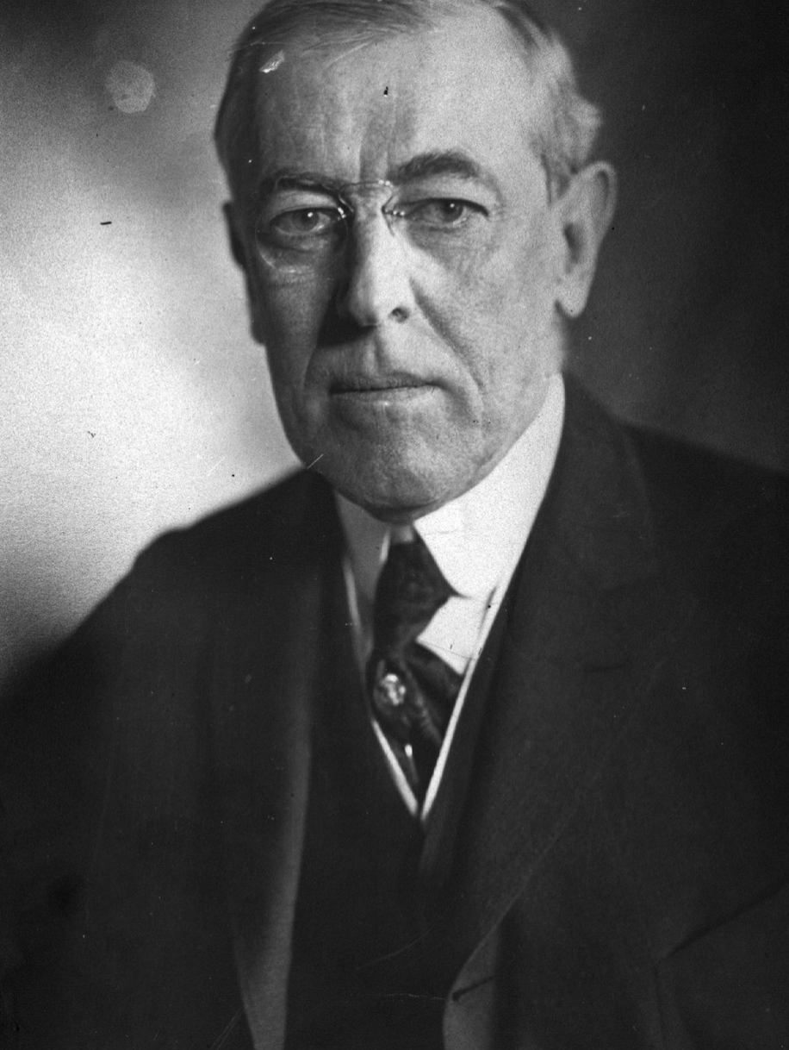
Racial Hierarchies
Woodrow Wilson:
A great change in the character of immigration which our newly industrialized country began now to attract from abroad. Down to 1880 the vast proportion of immigrants to this country were from the easily assimilable stock of western Europe, who, upon their arrival here, largely sought the land…. There is no longer any land to seek, and even if there were, the poverty-stricken Italians, Hebrews, and Slavs, who in 1905 made up three fifths of the immigrant arrivals to these shores, are neither disposed nor able to make their way to it.
The general questions raised by the new type of immigration on a large scale were first raised, and in an exceptionally acute form, by Chinese immigration. Chinese began coming to this country in considerable numbers about the close of the Civil War and were of the greatest possible service in completing the great transcontinental railways. The Treaty of Washington with China in 1868 was therefore giving voice to no mere banality in recognizing the mutual advantage of this migration. But it was also this very fact of the completion of the Pacific roads that brought about a great reversal of feeling with regard to the Chinese, who now began to make their way eastward, where their abhorrent social arrangements and filthy habits of living made them local nuisances….
In 1879 Congress passed a resolution ordering the President to declare the Treaty of 1868 null and void…. The Angell Treaty of 1880, according the United States permission to "regulate, limit, or suspend" the immigration of Chinese laborers. The bill passed by Congress early in 1882 "suspended" such immigration for twenty years, but a presidential veto brought about a reduction of this term to ten years in the measure that was finally enacted.
The same year, its attention being now upon the immigrant problem, Congress decreed the exclusion of paupers, criminals, convicts, and insane persons, and imposed a poll tax of fifty cents…. By the Act of 1890 polygamists, diseased persons, and persons incapable of self-support, were excluded. By the Geary Act of 1892 and an Act of 1902 Chinese exclusion was renewed and made more stringent… By the Act of 1903 the capitation tax upon immigrants was raised to two dollars…
3:30 of audio in this slide
Notes:
In the beginning–that is, in 1620—the American colonists from Britain thought the only proper church-going Puritans should be full members of society. All others, whether Native Americans or Portuguese fisherman or those who did not attend the Puritan church regularly, especially (shudder) Episcopalians, were viewed with suspicion, and kept somewhat separate.
But time passed. More people came. Assimilation happened. Benjamin Franklin in 1770 accepted all English speakers from birth as equally good, and viewed German immigrants with a grave suspicion. By 1850 German immigrants were absolutely fine—as, indeed, were all White Anglo-Saxon Protestants, WASPs (Germans, you see, were Saxons). It was the Irish who belonged in the paddywagons. How many of you have heard that term? How many of you know what it means?
Here we have a long quote from American Democratic President (1912-1920) Woodrow Wilson, about how increasingly America is under threat from immigrants who will not, cannot assimilate and make their way: African-Americans, of course—Wilson as president segregated the U.S. government’s civil service, which Republicans had desegregated after the Civil War—and Chinese and Japanese. But also the “poverty-stricken Italians”, “Slavs”—let’s not tell Putin or his friends in the U.S. government—and “Hebrews” do not belong in America. They are beyond the pale.
“Beyond the pale” is an English expression. When England ruled Ireland with Dublin as its capital, English law and English customs were enforced within the “Pale of Settlement” around Dublin itself. Outside were the wild, uncivilized, probably racially-inferior Irish—anything “beyond the pale” is uncivilized and not worth reasoning with, or maybe it is just not possible to reason with it.
Curiously enough, for Woodrow Wilson the Irish-Americans were not beyond the pale. There were too many of them, and too many of them voted for Democratic politicians. Irish, no matter how poverty-stricken and how Catholic they might be, were “British” and thus in the favored group, perhaps on the level of the Dutch.
The tendency to rank human ethno-linguistic groups in a definite, strict, and firm linear hierarchy has always been present, perhaps. We do have another letter from Cicero, this time to his best friend Titus Pomponius Atticus, in which Cicero says that the British are too stupid and uncivilized to even make good slaves. Was this tendency at its height in the late 1800s and early 1900s? Perhaps. How far has it retreated?
I confess that when I look at India, Hungary, and the United States today, I must conclude it has not retreated as far as I optimistically believed it had. And I think that one of the conservative causes at Stanford a couple of years ago was that some students did not welcome but protested the appearance of right-wing American Enterprise Institute fellow Charles Murray on the campus—the same Charles Murray who in his younger days thought it would be fun to scare the shit out of the two black families who lived in the small Indiana town he grew up in by burning a KKK cross one evening.

Slide 7
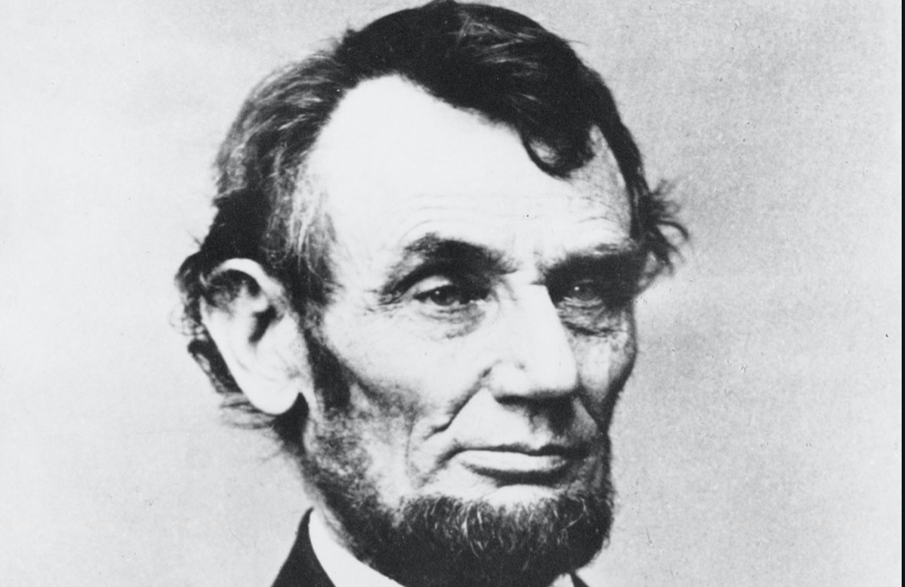
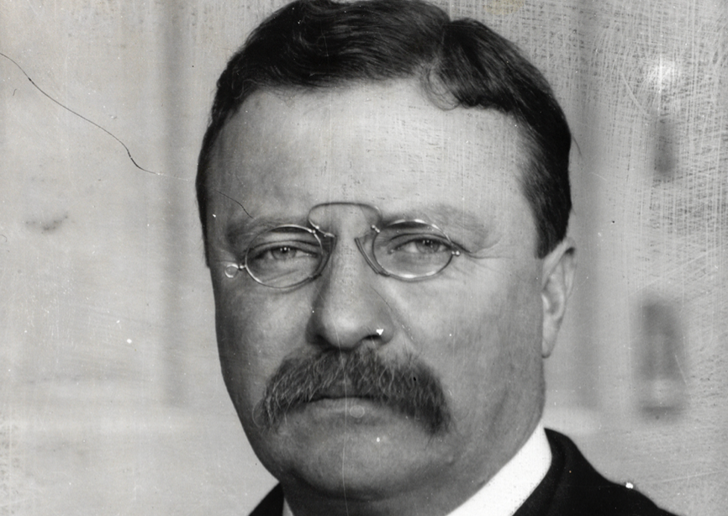
But See Also…
Abraham Lincoln:
There is no reason in the world why the negro is not entitled to all the rights enumerated in the Declaration of Independence-the right of life, liberty, and the pursuit of happiness. I hold that he is as much entitled to these as the white man. I agree with Judge Douglas that he is not my equal in many respects, certainly not in color-perhaps not in intellectual and moral endowments; but in the right to eat the bread without the leave of any body else which his own hand earns, he is my equal and the equal of Judge Douglas, and the equal of every other man…
Theodore Roosevelt:
There is nothing easier than to belittle the great men of the past by dwelling only on the points where they come short of the universally recognized standards of the present. .Men must be judged with reference to the age in which they dwell, and the work they have to do.... We have traveled far since [the Puritan's] day. That liberty of conscience which he demanded for himself, we now realize must be as freely accorded to others as it is resolutely insisted upon for ourselves.
The splendid qualities which he left to his children, we other Americans who are not of Puritan blood also claim as our heritage. You, sons of the Puritans; and we, who are descended from races whom the Puritans would have deemed alien—we are all Americans together. We all feel the same pride in the genesis, in the history, of our people; and therefore this shrine of Puritanism is one at which we all gather to pay homage, no matter from what country our ancestors sprang.
We have gained some things that the Puritan had not—we of this generation, we of the twentieth century, here in this great Republic; but we are also in danger of losing certain things which the Puritan had and which we can by no manner of means afford to lose..
1:30 of audio in this slide
Notes:
But even in the late 1800s the likes of Woodrow Wilson were not the only powerful voices.
We do not really know what the "perhaps" in the Lincoln quote above means. Does it mean “I don’t agree, but I have more important issues to talk about right now”? Or does it mean “I think so, but I am not an expert”?
What is clear is that Abraham Lincoln believes that African-Americans are equal citizens entitled “to all the rights enumerated in the Declaration of Independence” and that every African American “in the right to eat the bread without the leave of any body else which his own hand earns, he is my equal and the equal of Judge Douglas, and the equal of every other man…”
And Theodore Roosevelt—who believed that everybody had a positive duty to become as much like he thought an American should be as they possibly could? Theodore Roosevelt did not believe in inheritance. He, rather, believed in heritage—heritages that anyone could claim. And he was clear that he meant “claim” rather than “worship”. “We have”, he said, “travelled far since the Puritan’s day” and understand what the Puritans did not: that freedom of conscience is for all.
These issues of demography, inclusion, ethnicity, and hierarchies by birth, and their effects and their transformations under the gun of the explosion of wealth technology and globalization make up our second set of themes. Who are the full citizens, and thus who have claims to full participation in and access to the resources of the human community?

Slide 8
Catch Our Breath…
Ask a couple of questions?
Make a couple of comments?
Any more readings to recommend?
<>

